Slide 1


EnergyWise
Static Energy Estimation Pass for RISC-V (rv32imc)
Course: CS363IA — Compiler Design Lab (Semester VI)

Slide 2
Our Team
Name | Branch | USN | Email
Astitwa Tanmay | CS | 1RV23CS056 | astitwatanmay.cs23@gmail.com
Ayush Aman | CS | 1RV23CS059 | ayushaman.cs23@gmail.com
Bhargavi Subray Bhat | CS | 1RV24CS404 | bhargavisb.cs24@rvce.edu.in

Slide 3
Introduction
In modern embedded and IoT computing, software optimization heavily impacts battery life and energy efficiency. Traditional methods for measuring energy consumption require expensive physical hardware or slow, cycle-accurate simulation frameworks that take hours to run. To bridge this gap, we introduce EnergyWise a completely static LLVM compiler pass that estimates program energy consumption directly in nanojoules ($nJ$) without code execution. Explicitly targeting the open-source RISC-V rv32imc core, our system analyzes code loops, handles memory locality context, and accounts for branch misprediction penalties at compile time. Ultimately, this framework provides developers with instant, actionable feedback to identify energy hot-spots and rank compiler optimizations early in the design cycle

Slide 4
Problem Statement
Battery Constraints: IoT edge nodes operate under strict energy budgets, where software structure heavily impacts device battery life.
Slow Simulations: Existing methods require physical hardware setups or extremely slow simulators (like gem5) that take hours to run.
Context Blindness: Current static tools treat every instruction as a flat cost, completely ignoring cache hits/misses and pipeline switching hazards.

Slide 5
Objectives
Statically Predict Energy: Compute exact code energy footprints in nanojoules ($nJ$) directly from LLVM IR, completely eliminating the need for physical hardware or active runtimes.
Model Pipeline Context: Integrate dynamic hardware realities—specifically operand switching variables, loop memory reuse distance, and branch misprediction stalls—directly into a static framework.
Rank Code Transformations: Automatically compare and rank optimized code variants (such as loop unrolling, tiling, and strength reduction) to mathematically guarantee energy reduction.
Ultimate Goal: To bridge the gap between fast static compilation and accurate physical power profiling for sustainable embedded software.

Slide 6
Existing Systems
Technique | How it works | Key Drawback
Cycle-accurate sim (gem5 + McPAT) | Full functional + micro-architectural simulation of every cycle. | Hours per run; needs proprietary models; not a compile-time pass.
Flat instruction counting (Tiwari) | Static per-opcode energy table summed over the program. | Context-blind: identical estimate for very different memory behaviour.
Operand-level (Steinke 2001) | Models bit-level Hamming distance of operand buses. | Needs hardware capacitance tables unavailable for RISC-V.
ML energy models | Regression / LSTM trained on measured execution traces. | Requires labelled RISC-V training data; opaque & hard to debug.

Slide 7
PROPOSED SOLUTION
Operand Switching Activity ($\alpha$): Estimates bit-level toggling patterns purely from software operand types, scaling node energy from 0.3x for constants up to 1.2x for complex phi-nodes.
Memory Reuse Distance: Utilizes a local loop-bound reuse heuristic to accurately predict cache miss probability ($p_{miss}$), scaling dynamically between L1 hits and main memory stalls.
Branch Predictability: Accounts for pipelined control-flow overheads by injecting a physical 3.5 nJ penalty penalty weighted against a static baseline 10% misprediction rate.
E = ( E_base + (α_switch × E_switch) + (p_miss × E_miss) ) × ∏(Trip Counts)
LLVM New-PM | C++17 Plugin | Python Simulation | PyYAML Cost Model | RISC-V rv32imc Core

Slide 8
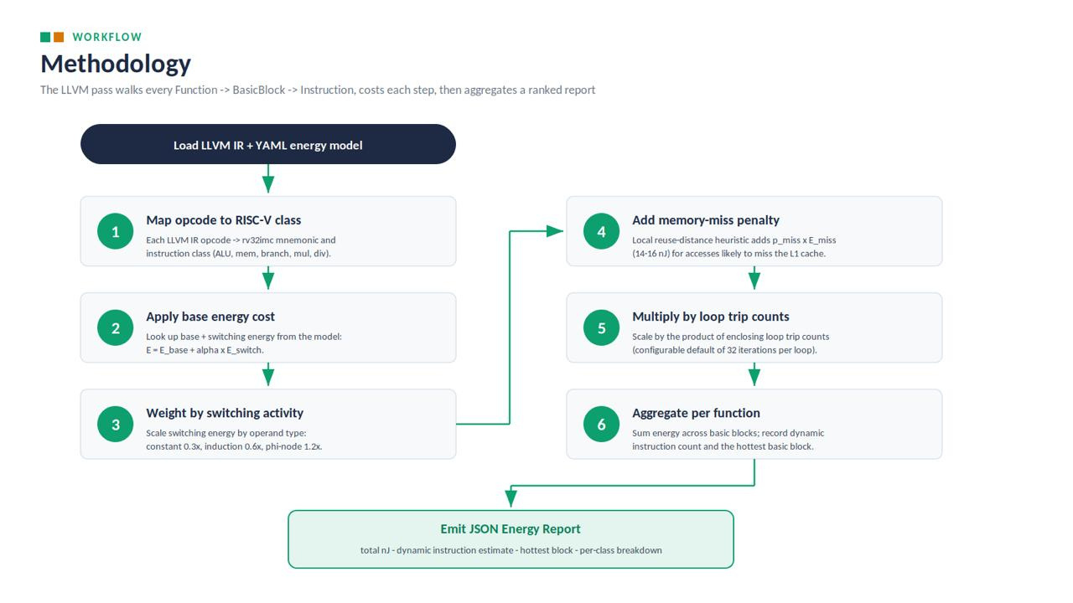
Methodology
EnergyWise Framework Workflow & Pipeline Stages

Slide 9
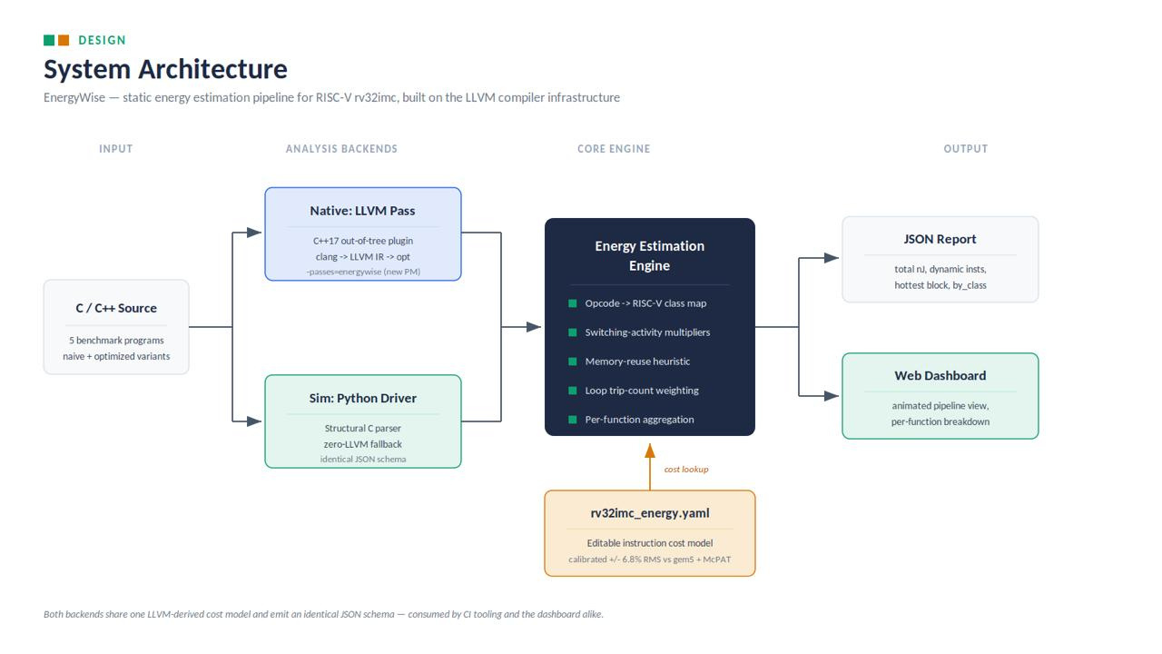
SYSTEM ARCHITECTURE
Dual-backend execution flow sharing a unified YAML cost model and emitting an identical JSON schema.

Slide 10
Literature Survey
Paper / Work | Publication | Authors | Key Findings
Static Analysis of Energy Consumption for LLVM IR Programs | SCOPES (ACM); arXiv 1405.4565 | Grech, Georgiou, Kerrison, Morse, Eder | Infers energy formulae from LLVM IR via symbolic execution; validated on Cortex-M & xCORE — basis for IR-level estimation.
Inferring Parametric Energy Functions: ISA vs LLVM IR | Springer LNCS (FOPARA) | Grech, Georgiou, Pallister et al. | Compares ISA-level vs IR-level energy models; IR offers the best analyzability–accuracy trade-off.
LLM-assisted Performance & Energy Estimation on RISC-V | ResearchGate / preprint, 2025 | (see citation) | Couples instruction-level static analysis with data-driven regression; avoids dynamic instrumentation.
Run-Time Energy Efficiency via Controlled Approximation in a RISC-V Core | arXiv 2410.07027, 2024 | (RISC-V approx-computing group) | Reports 13.3 pJ/instruction at 500 MHz (45nm); quantifies per-stage energy savings from approximation.

Slide 11
Literature Survey
Paper / Work | Publication | Authors | Key Findings
SystemC-AMS Power Modeling + RISC-V ISS (GAP9/PULP) | ACM ISS, arXiv 2404.01861, 2024 | Vinco et al | Integrates power dynamics with functional ISS for battery-operated PULP RISC-V virtual prototypes.
IoT Processor Power Prediction via Instruction Dissection | IEEE Access, 2024 | Yusuf, Ahmed, Onwuka, Suleiman | Instruction-dissection regression predicts processor power for IoT cores from instruction mix
Low-Power RISC-V Core for Energy-Constrained Edge Devices | J. Integrated VLSI & Embedded Comp. Tech., 2026 | Teyene, Taconi | Micro-architectural low-power core design for battery / energy-harvesting edge nodes
Accurate Instruction-Level Energy Model for Embedded RISC | J. Integrated VLSI & Embedded Comp. Tech., 2026 | Tiwari et al | Per-instruction energy from measured current draw — classic flat-counting baseline EnergyWise improves on

Slide 12
NOVELTY & INNOVATION
Three-Signal Context Modeling: Combines operand switching activity, memory-reuse distance, and branch predictability to achieve simulation-level accuracy statically, outperforming traditional flat instruction counters.
Transparent and Inspectable Cost Tables: Replaces opaque "black-box" machine learning models with human-readable, fully editable YAML cost configurations for instant core re-tuning.
Dual-Backend Execution Pipeline: Features a high-fidelity C++ LLVM pass paired with a zero-dependency Python driver simulator that share a unified schema and produce identical JSON reports.
Retargetable Compiler-Level Design: Operates directly at the LLVM IR level, making the energy estimation framework completely independent of the source language (C, C++, Rust) and easily portable to different ISA variants.
Immediate Developer Feedback: Runs seamlessly within seconds as a standard compiler module pass, integrating power-awareness directly into the daily edit-compile-optimization cycle.

Slide 13
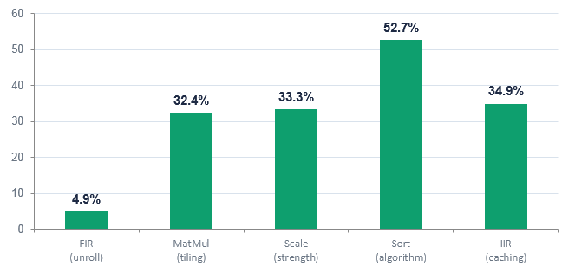
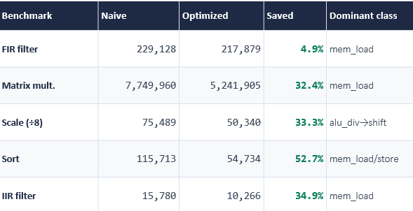

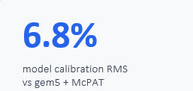
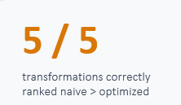
Results
Energy reduction from each transformation
Verified energy (nJ): naive → optimized

Slide 14
FUTURE SCOPE & LIMITATIONS
Translating current architectural limitations into future development opportunities for advanced static estimation.
Symbolic Loop Analysis: Integrate LLVM ScalarEvolution to track and resolve dynamic trip counts, replacing fixed iteration defaults with precise symbolic bounds.
Inter-Block Memory Reuse Tracking: Expand the cache analysis framework across multiple basic blocks to significantly refine global memory miss-rate predictions.
Profile-Guided Branch Weights: Incorporate real-world program execution metadata into the optimization pipeline instead of relying on a static 10% branch misprediction heuristic.
Multi-Target ISA Extensions: Port and scale the YAML cost models to support broader hardware targets including rv32imac, rv64, and vector/floating-point pipelines.

Slide 15
References
[1] N. Grech, K. Georgiou, J. Pallister, S. Kerrison, J. Morse, and K. Eder, “Static Analysis of Energy Consumption for LLVM IR Programs,” in Proceedings of the Workshop on Software Technologies for Embedded and Cyber-Physical Systems (SCOPES), ACM, 2015. Available: arXiv:1405.4565.
[2] N. Grech et al., “Inferring Parametric Energy Consumption Functions at Different Software Levels: ISA vs. LLVM IR,” Formal Optimization and Runtime Aggregation (FOPARA), Springer LNCS.
[3] “LLM-assisted Performance Estimation of Embedded Software on RISC-V Processors,” Preprint, 2025.
[4] “Evaluation of Run-Time Energy Efficiency using Controlled Approximation in a RISC-V Core,” arXiv preprint arXiv:2410.07027, 2024.
[5] A. Vinco et al., “Integrating SystemC-AMS Power Modeling with a RISC-V ISS for Virtual Prototyping,” arXiv preprint arXiv:2404.01861, 2024.
[6] D. Yusuf, H. Ahmed, E. Onwuka, and Z. Suleiman, “IoT Processor Power Utilization Prediction Using Instruction-Dissection,” IEEE Access, vol. 12, 2024.reprint arXiv:2404.01861, 2024.

Slide 16
Thank You

